Slide 1
Naval Education and Training Professional Development Center (NETPDC)
Advancement Exam Readiness Review (AERR)
July 2026

Slide 2
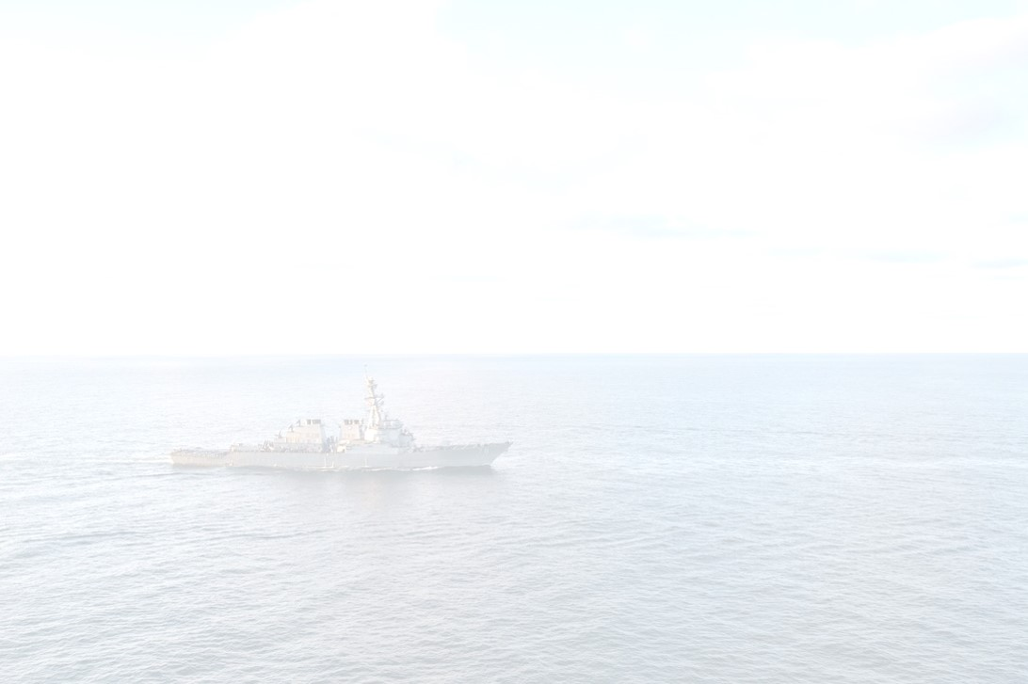
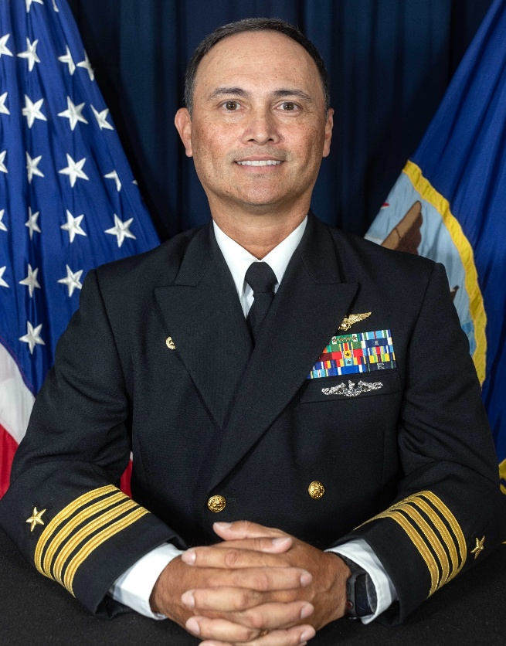
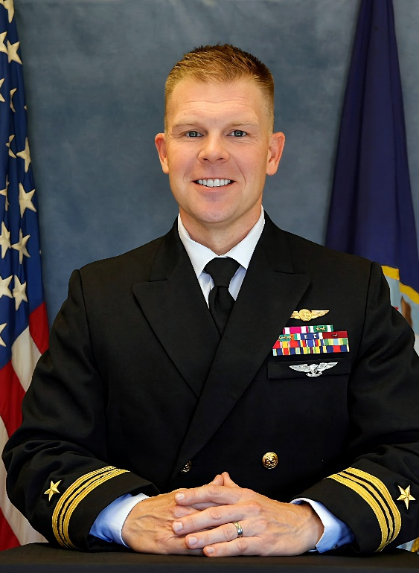
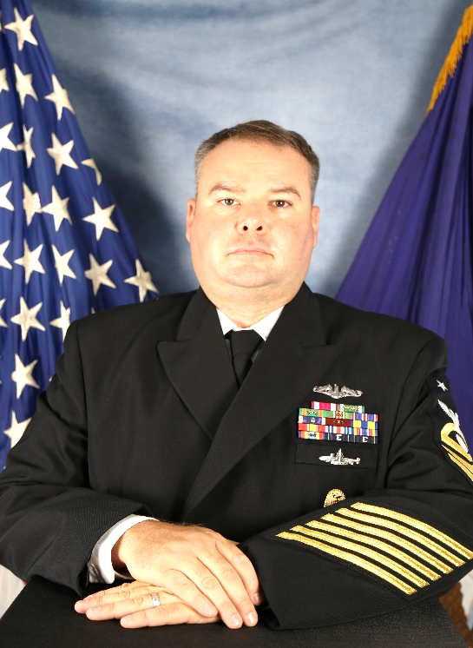
NETPDC Leadership
Commanding Officer
CAPT Roger Phelps
NAC Director
LCDR Robert Luers
Command Master Chief
EMNCM Andy Rockman

Slide 3
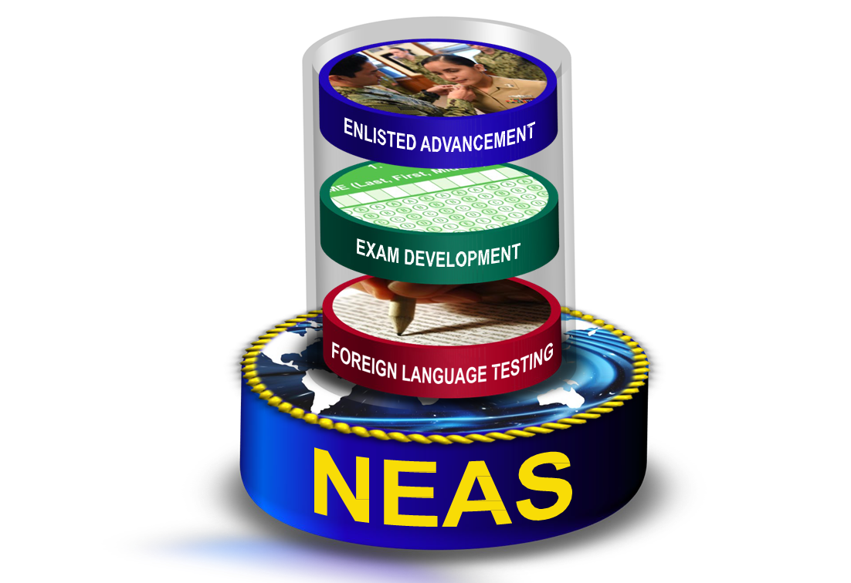
Navy Advancement Center (NAC)
SAILOR
E4 – E9 ACTIVE & RESERVE
Advancement Exams Discrepancy Issues, Profile Sheets, and Facebook Page
CNO (N1)
OPNAV N13
Policy & Guidance Advancement Plan Quotas, and
Monthly Increments Advancement Manual
FLEET
CO/XO/CMC/CCC/ESO
Exam Ordering,
Enlisted Advancement Worksheet Exam Administration Advancement Results,
Candidate Data, and Command Data Fleet SMEs
COMNAVRESFOR
SELRES
Policy & Guidance Advancement Plan Quotas, and
Monthly Increments
MNP
ADVANCEMENT & PROMOTIONS
Enlisted Advancement,
My Dashboard (E4-E6) NAC Resources & Links, and Exam Bibliographies
NPC
PERS 3/4/8
Policy & Guidance Personnel Decisions Advancement Results Advancement Data, and
Selection Board Eligibility
NAVY SYSTEMS
NEAS INTERFACES ADE 2.0, BOL, CeTARS CNP_PAO COMNAVRESFOR DEERS, DLA, DMDC MY_EDUCATION
NECB, NP2 NSIPS, OARS, OPAS
OPINS, OPNAV, NAVMAC
NETC
NETC N5/N6/N7
Program Guidance Funding,
IT Approval, and IT Support

Slide 4
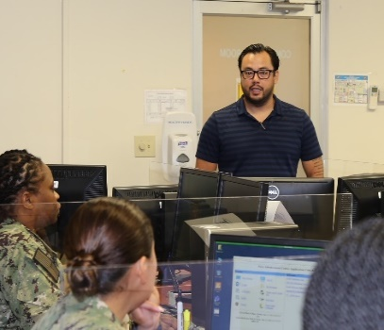
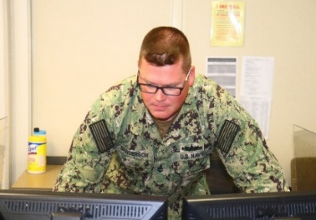
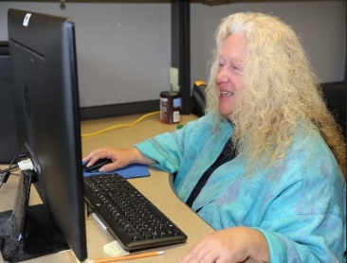
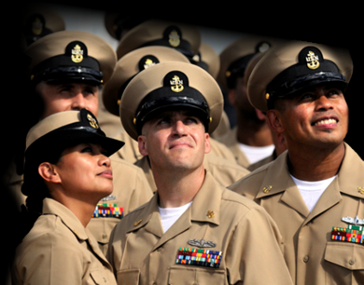
AERR Support Team
Team Leader (TL)
Content Validity Chief (CVC)
Graphic Illustrator
Fleet Subject Matter Experts (FSMEs)
Team leaders provide continuity for each rate and are the driving force behind advancement exam creation and question bank management.
CVCs are responsible for maintaining Test Plan Information Packages, rating strategy plans, and are the military component to assigned ratings.
Graphic illustrators are responsible for providing visual content for questions within the exams.
SMEs are the primary conduit for exam validity within the rate ensuring exams are current, relevant, and correct.

Slide 5


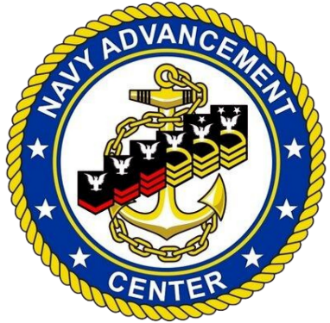
AERR Process
NAVADMIN announces 6-month AERR schedule
TYCOM Rating Sponsors select FSMEs
AERR Team:
Reviews & verifies references
Validates questions
Validates exam bank
Writes new questions
Reviews and drafts graphics
NAC hosts AERR at NAS Pensacola

Slide 6
Who Should Volunteer?
E7-E9
Active security clearance
No Adverse Evaluation in last 3 years
Must Promote on latest Evaluation (W)
Be within BCA standards and passed most recent PFA
No Fleet Reserve, retirement or HYT date within 1 year (W)
CMC & CO endorsement required
*(W) = Waiver on a case-by-case basis

Slide 7
Why Should You Volunteer?
Direct Fleet Impact: You ensure that upcoming advancement exams are fair, accurate, and test the most up-to-date policies and occupational standards for junior Sailors.
Professional Networking: You collaborate and network with fellow Chiefs, Senior Chiefs, and Master Chiefs from various commands and platforms across the Navy.
Knowledge Enhancement: Immersing yourself in rating manuals and exam banks strengthens your own subject matter expertise, which you can take back to mentor your junior Sailors.

Slide 8
How To Volunteer
Review NAVADMIN for applicable timelines
Visit MNP to complete nomination package
Forward completed application with CMC & CO endorsement to TYCOM Rating Sponsor
If selected, you will receive a Welcome Email with follow on instructions from the NETPDC AERR team
NOTES:
OCONUS: Parent command is responsible for flight funding. NETPDC will cover all other expenses as applicable.
CONUS: All applicable expenses covered by NETPDC

Slide 9
Questions
More AERR information:
  MNP
AERR questions:
  NETPDC_AERR_Mailbox@us.navy.mil

